Slide 1
netduino
Boise Code Camp 2014
Scott Jeide
@ScottJeide

Slide 2
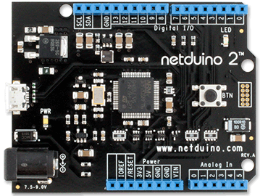
Netdu-what?
Open Source HW Platform
.NET Micro Framework
Visual Studio
~$60

Slide 3
What can it do?
Connectivity
HW Specs
USB
Ethernet
22 I/O pins
Digital
Analog
UART
PWM
Micro SD
Shields
32-bit 120MHz
384 KB ROM
100 KB RAM
5 V power

Slide 4
Development Environment
Visual Studio 2010 (Express OK)
Visual Studio 2012 (sort of)
Netduino SDK
.NET Micro Framework SDK
USB

Slide 5
.NET Support!
CLR 1.0 / .NET 1.1 +
IEnumerable
Extension methods
Yield
Lambdas
Events
Timers
Threads
HttpWebRequest
Input/OutputPort
AnalogInput/Output
InterruptPort
Debug
Trace
Math

Slide 6
Get On With It!

Slide 7
Gottchas
No https
No xml/json parser
No string.Format
No generics (and no LINQ)
Watch analog inputs – can cause reboot problems

Slide 8
Best Practices
using(…) and IDisposable are your friends
Use SD card for large HttpWebResponses
Debug.EnableGCMessages(true);
Catch Exceptions
Make Main() a watchdog
Do work in threads
Initialize pins – no floaters
Keep InterruptPorts in scope

Slide 9
Helpful Links
www.netduino.com
http://www.netduino.com/downloads/gettingstarted.pdf
http://informatix.miloush.net/Microframework/Articles/CisFeatures.aspx
http://www.amazon.com/Getting-Started-Electronics-Forrest-Mims/dp/0945053282
http://msdn.microsoft.com/en-us/library/hh423649.aspx

Slide 10
Thanks
Go Make Something!
Follow me @ScottJeide
Scott.Jeide@live.com
https://github.com/scottjeide/BCC-NetDuino

